Slide 1


Client side performance
by Martin Chaov

Slide 2

Hi, I’m Martin!
Tech enthusiast
Software architect
Ex-designer
...at least for me...

Slide 3

Who is in my
audience?
Notes:
Who are you?
- FE Developers
- BE Developers
- Real hardcore programmers xD
- Who else?

Slide 4


Slide 5

The issue at hand
What is performance
Navigation Timing API v2
Beacon API
Demo
Tools
Q/A

Slide 6

OMFG
so slow…
Just give it
1 more min!
Notes:
My site loads in 20sec. … fix it!
It all starts with a simple issue ... in my case a few million dollar issue :)
Fix the performance of the web application...

Slide 7

PLEASE
LOAD!
Notes:
My site loads in 20sec. … fix it!
It all starts with a simple issue ... in my case a few million dollar issue :)
Fix the performance of the web application...

Slide 8

Notes:
Most of the developer have been there.
On general we are doing few different tests on our software before release and during it's version life cycle.
- Sanity, Smoke, Regression ... etc.
- Pen tests
- Performance tests
- Stress tests
Then we release ... and production bugs start to appear :D

Slide 9
What is performance?
The accomplishment of a given task measured against preset known standards:
Accuracy
Completeness
Cost
Speed
Notes:
I tested my app and it loads in X.XX

Slide 10
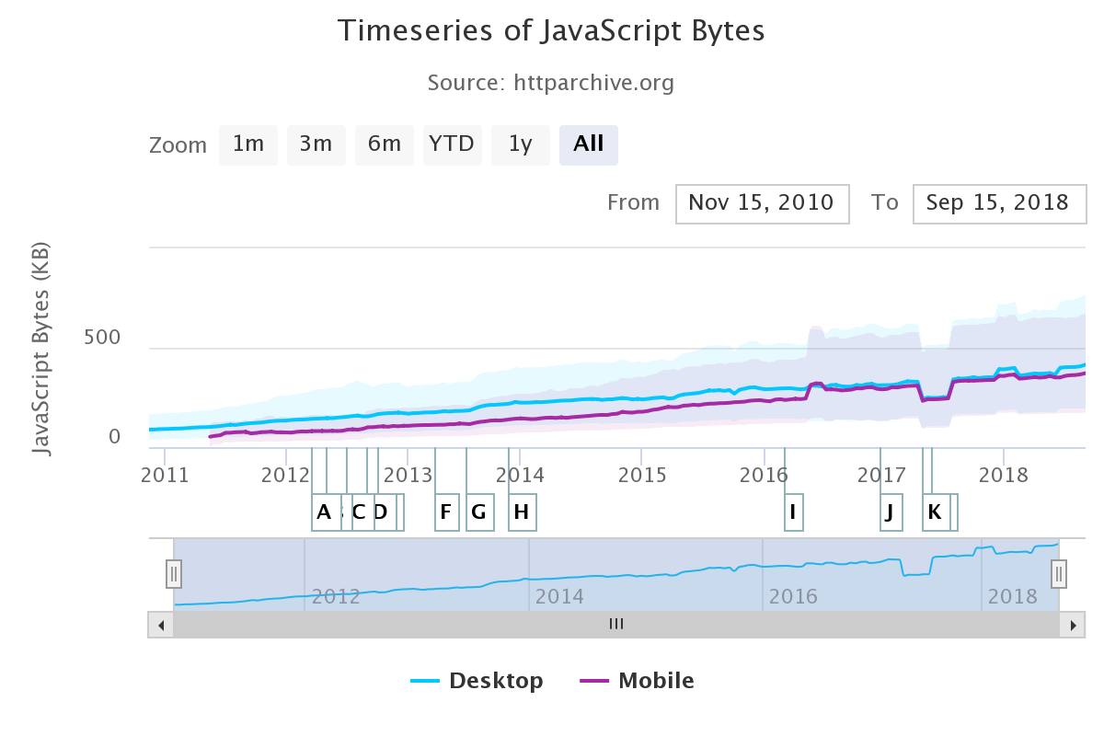
Date | Desktop | Mobile
05.2011 | 101.6 KB | 52.4 KB
10.2018 | 415.6 KB | 372.4 KB
Delta | 369.1% ^ | 610.7% ^

Slide 11


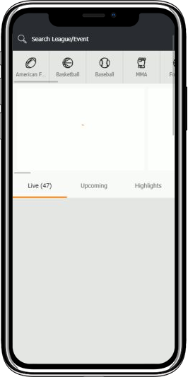
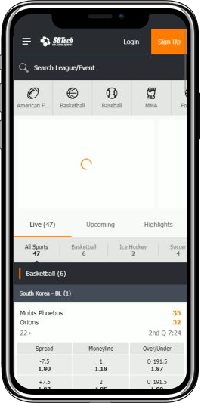
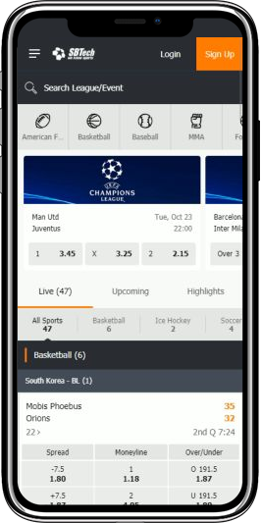
Start…
First
Paint
First
Contentful
First
Meaningful
Fully
Loaded
Notes:
When did the page become interactive?

Slide 12

Notes:
Where do we start?

Slide 13
Split performance into areas
Server-side
Client-side
Network
E2E?

Slide 14
Client side
Audit
Chrome Dev tools
Catchpoint
WebPageTest
SpeedCurve

Slide 15
Google Chrome tools

Slide 16
Notes:
Audit

Slide 20
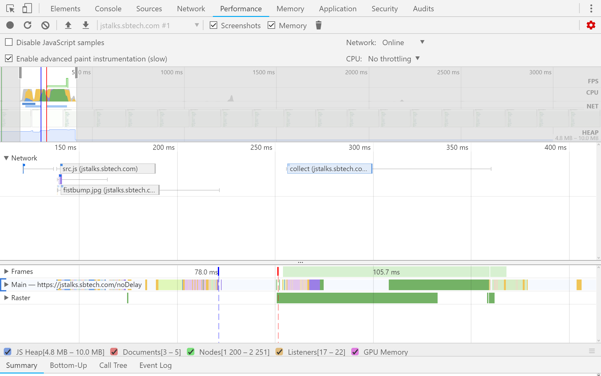
Notes:
Dev tools

Slide 21
Catchpoint

Slide 22
Notes:
Catchpoint

Slide 27
A tale of CDNs…

Slide 28
A tale of CDNs and ISPs
Same file
4 CDNs
5 ISPs

Slide 30
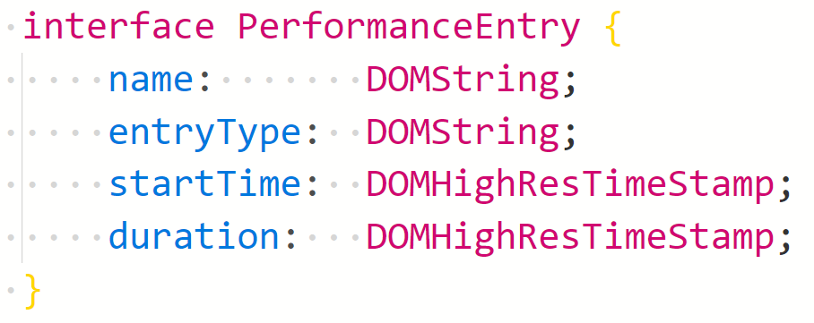
Navigation Timing

Slide 31
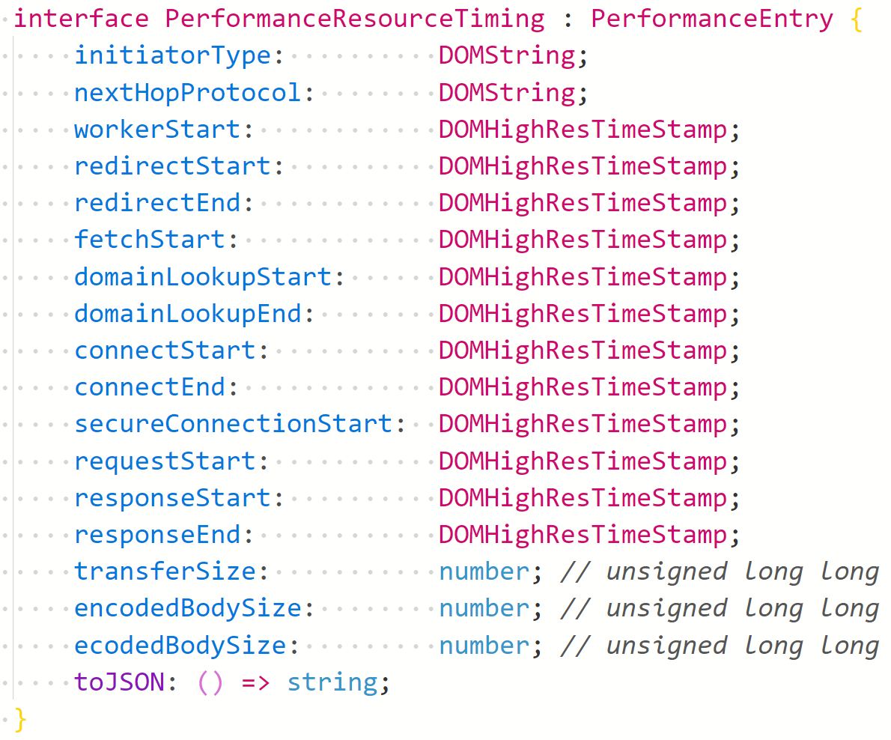
Navigation Timing

Slide 32
Prompt
for unload
Redirect
Service
Worker
DNS
TCP
Request
Response
Processing
Load
Unload
DOMContentLoaded

Slide 33
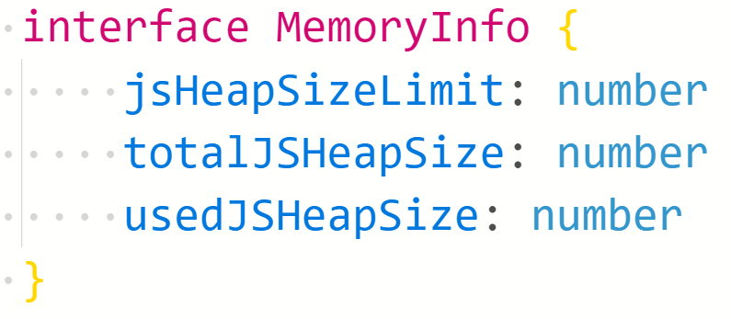
performance.memory

Slide 34
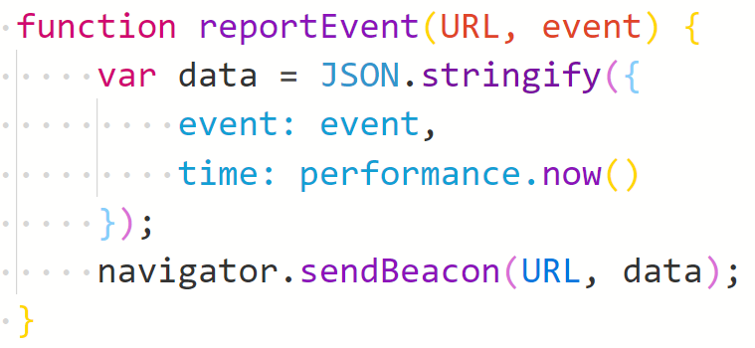
Beacon API
Super simple
Async
Sometimes works…

Slide 35
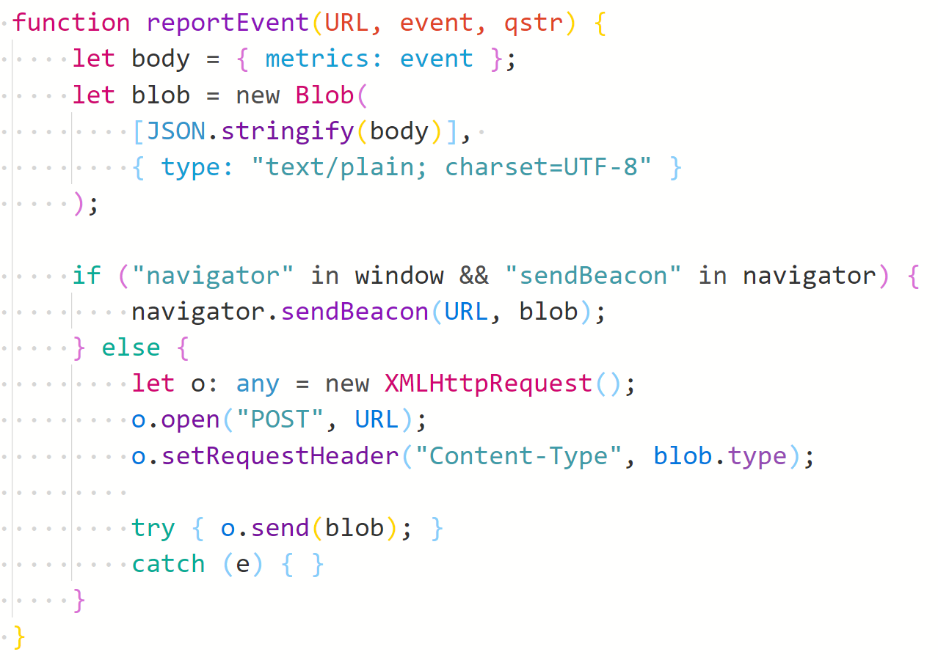
Beacon + Polyfill
Content-type pitfall
Polyfill needed

Slide 36

Notes:
Pitfalls

Slide 37

Notes:
Math is hard … all of these metrics are numbers … so …

Slide 38

Notes:
Browser support

Slide 39
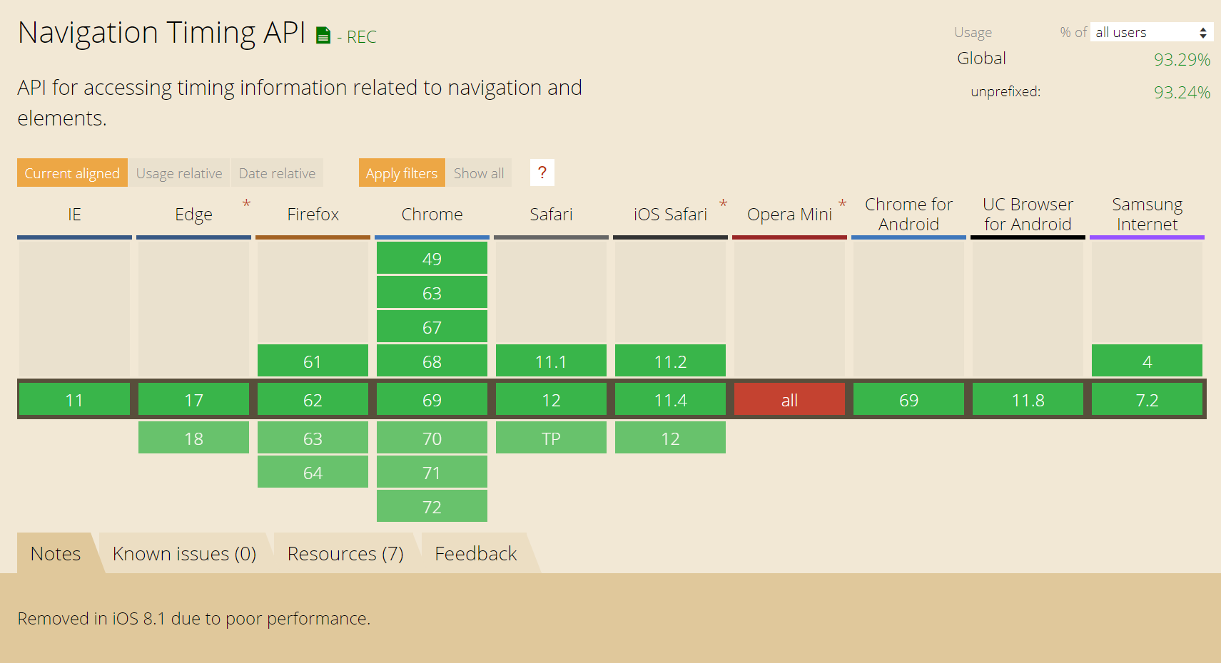

Slide 40
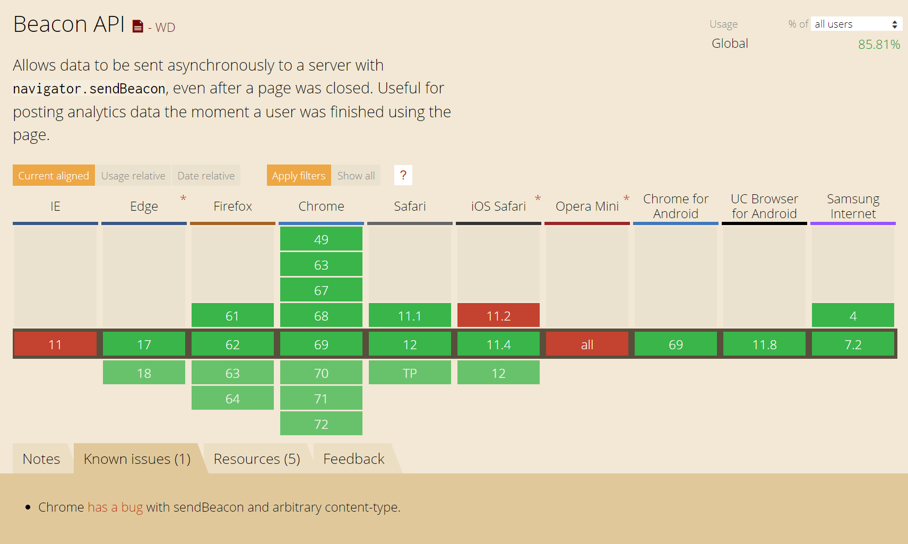

Slide 41

jstalks.sbtech.com
Notes:
DEMO

Slide 42
Some tools to help you out
Server-side:
ProcDump
dotMemory
ANTS Performance Profiler
AppDynamics
Client-side:
SpeedCurve
Google Analytics
Catchpoint
AppDynamics
Notes:
This is why I am going to skip it. There are challenges there! However, we usually have full access to the hardware and monitoring it is not so complicated.
Also you can run the entire application on your machine and do profiling and so on.

Slide 43
Summary
Perceived performance
Navigation API
Memory logging
Beacon API

Slide 44


Slide 45

Connect ☺
LinkedIn: https://goo.gl/CRRJ2Y
Mail: martin.c@sbtech.com
Github: https://github.com/mchaov
@raziel_pld

